Slide 1
HANDWRITTEN TEXT RECOGNITION USING 2D–PCA AND CNN
GUIDED BY:
Mrs.S.Selvi ASP/CSE
Team Members:
Nandha Kumar .T (710315104029)
Raja Mohammad.A (710315104040)
Shanmuga Manikandan.M (710315104046)
TamilSelvan.D (710315104058)

Slide 2
OBJECTIVE
To recognize the handwritten alphabets and numerical characters from an image of any picture format to a computer recognizable format using feature extraction technique called Two Dimensional Principal Component Analysis (2D-PCA) and Convolutional Neural Networks (CNN).

Slide 3
ABSTRACT
Handwritten character recognition has been one of the most fascinating research in the field of image processing.
The input is scanned from images in any format, documents and realtime devices and then interpreted into digital text.
Convolutional Neural Networks-for Classifying words
2-D Principal Component Analysis
-for feature extraction
-construct bounding boxes to translate handwritten text
to digital form

Slide 4
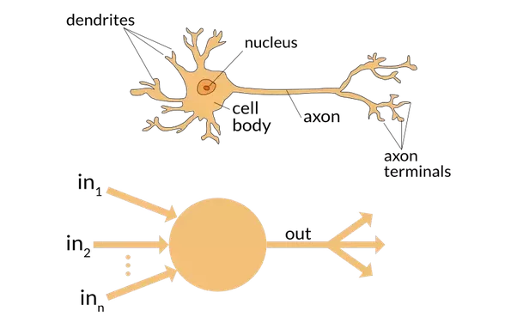
NEURAL NETWORKS
The handwriting recognition system can recognize a character of type format using ANN approach.
Artificial Neural Networks are computing systems vaguely inspired by the biological neural networks.
It is a framework for many different machine learning algorithms.
These systems learn to perform without being programmed with any task-specific rules.

Slide 5
NEURAL NETWORKS-COMPONENTS
Artificial neurons are analogous to their biological inspirers
Here the neuron is actually a processing unit.
It calculates the weighted sum of the input signal to the neuron to generate the activation signal a, given by
x₁
w_{1j}
w_{2j}
x₂
y_{j}
w_{nj}
x_{n}
where w_{i} is the strength of the synapse connected to the neuron, x_{i} is an input feature to the neuron
b_{j}

Slide 6
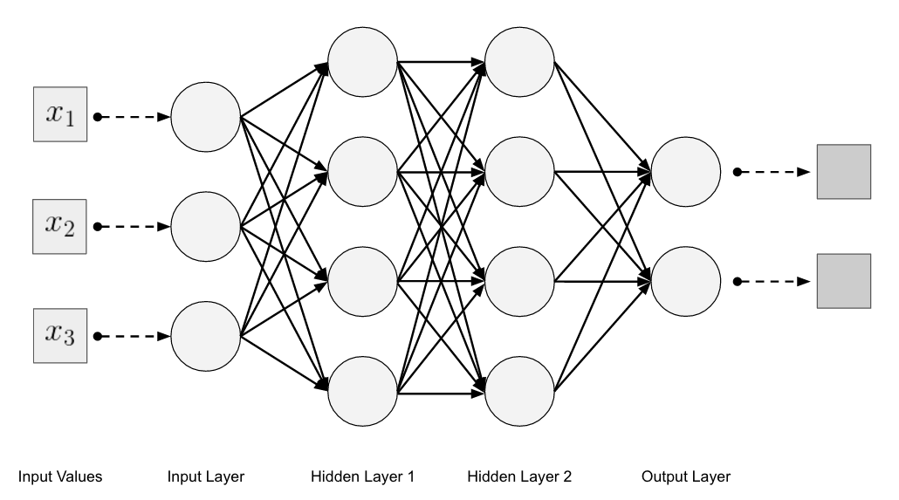
NEURAL NETWORK -ARCHITECTURE

Slide 7
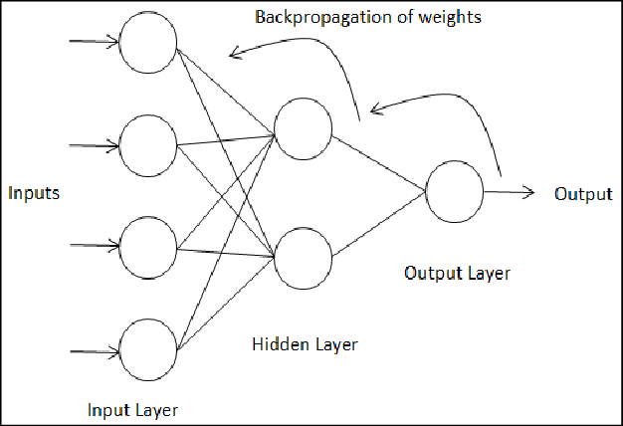
BACKPROPAGATION
Backpropagation is a method to calculate a gradient that is needed in the calculation of the weights to be used in the network.
Backpropagation is shorthand for the backward propagation of errors.
An error is computed at the output and distributed backwards throughout the network’s layers.
It is commonly used to train deep neural networks.

Slide 8
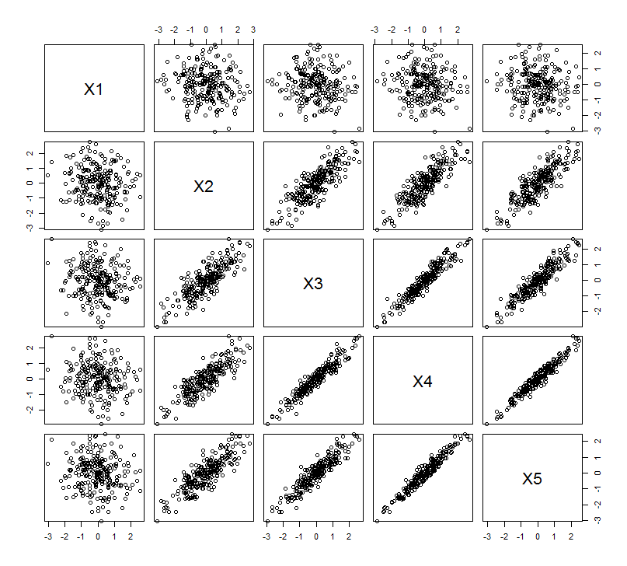
FEATURE EXTRACTION
Principal component analysis (PCA) is a statistical procedure that to convert a set of observations of correlated variables into uncorrelated variables.
CLASSIFICATION
CNNs use a variation of multilayer perceptrons designed to require minimal preprocessing based on their shared-weights architecture and translation invariance characteristics.

Slide 9
EXISTING SYSTEM
An input image(.jpg) is preprocessed by
Binarization
Smoothing
Noise Removal
Normalization
Feature Extraction and Selection by Genetic Algorithms.
Classification Algorithms are Multilayer Perceptron Neural Networks.
The Performance in terms of Accuracy is 86.56%

Slide 10
DEMERITS OF EXISTING SYSTEM
Less probability of accuracy.
Requires many repeated presentations of input patterns which affects optimality.
Genetic Algorithm is computationally expensive.
Designing objective function is difficult.

Slide 11
PROPOSED SYSTEM
An image of any format (.jpg,.jpeg,.png,.bmp,…) can be converted to a standard .jpg format.
The image undergoes the conventional preprocessing methods and are
Binarization
Smoothing
Noise Removal
Normalization
Segmentation
Feature Extraction can be performed by 2-Dimensional Principle Component Analysis.
Classification is implemented by Convolution Neural Networks.
The accuracy in the proposed CNN model is 97.30%

Slide 12
MERITS OF PROPOSED SYSTEM
Convolutional Neural Networks are
-easy to implement
-produces more accuracy.
It would be more accurate in Predicting images
Faster time process when compared to existing ones.
It would achieve improvement in optimality from 1-D PCA.
The system to predict characters with more accuracy and faster processing.

Slide 13
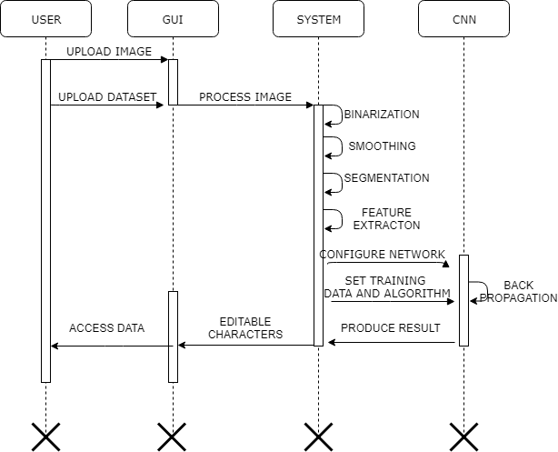
SYSTEM ARCHITECTURE

Slide 14
HARDWARE SPECIFICATIONS
Processor : i3
GPU: Nvidia with CUDA driver
RAM: 4GB
ROM: 500GB
SOFTWARE SPECIFICATIONS
-TensorFlow with Python Libraries such as
Tkinter
Tensorflow
Keras
Pillows
OpenCV
-EMNIST Balanced DataSet Model
-Colaboratory

Slide 15
LIST OF MODULES
1.Getting image:
Upload image.
Convert any format of image to JPEG.
2. Preprocessing:
Binarization
Smoothing
Dilation
Noise Removal
3. Segmentation:
Edge Detection
Fill Holes
Dilate Image
Apply Bounding Box

Slide 16
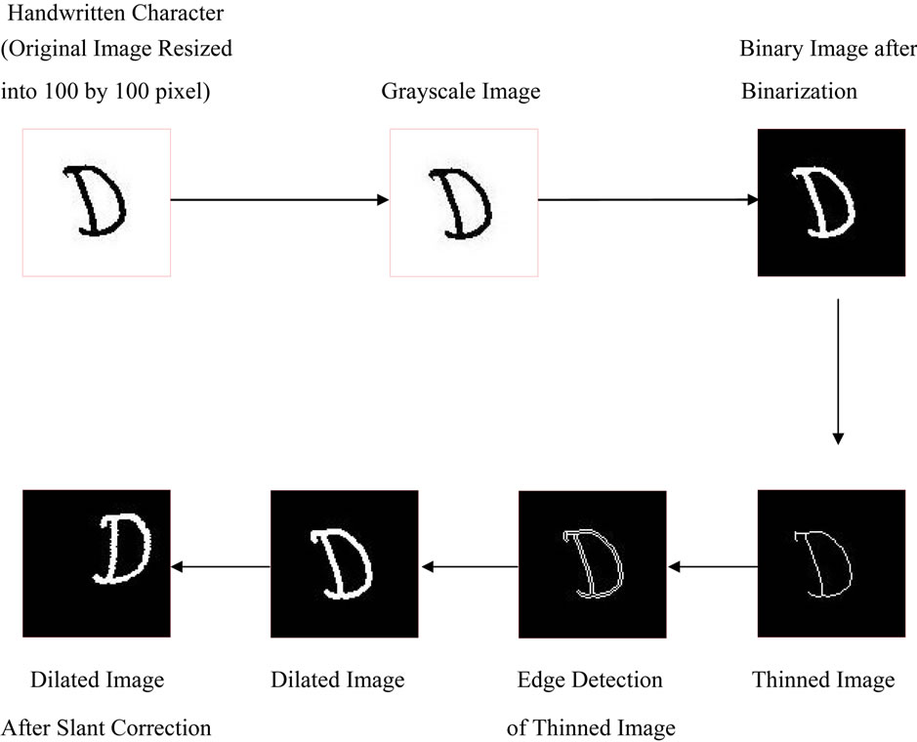
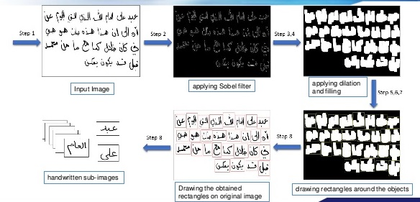
PREPROCESSING
SEGMENTATION

Slide 17
LIST OF MODULES
4.Feature Extraction:
Extract the Features
Pruning the feature dimension
Appling PCA
Scalar fit
Scalar transform
5.Classification:
Build the model
Compile and Fit the model
Get the accuracy on test set
6.Resulting Module:
Recognized Characters
Saving the file

Slide 18
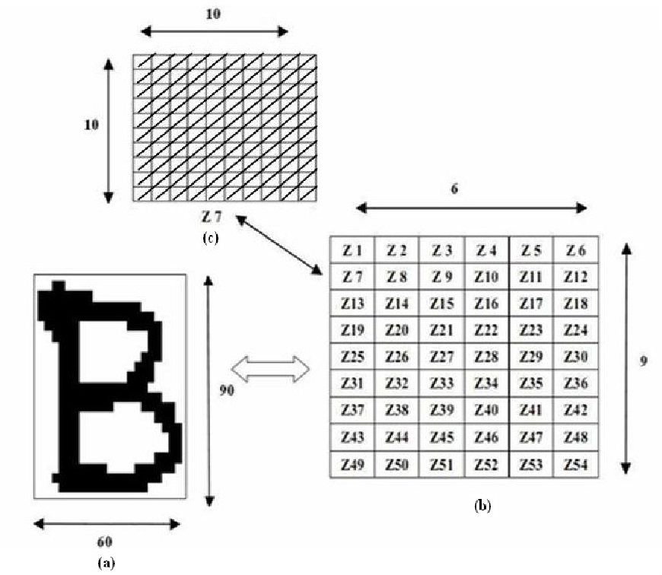
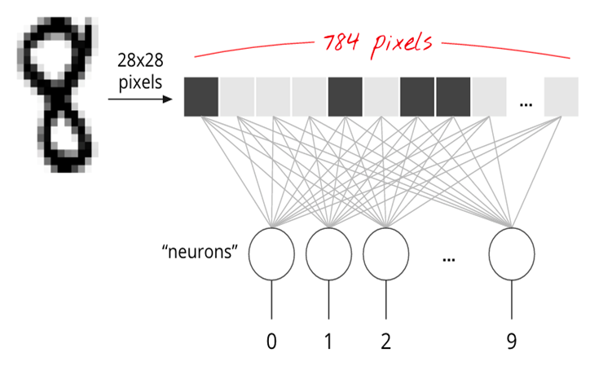
FEATURE EXTRACTION
CLASSIFICATION

Slide 19
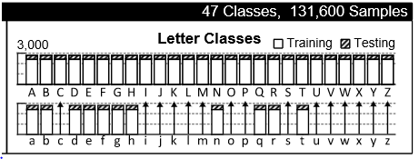
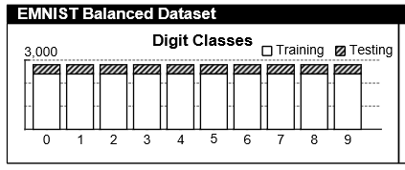

Slide 20
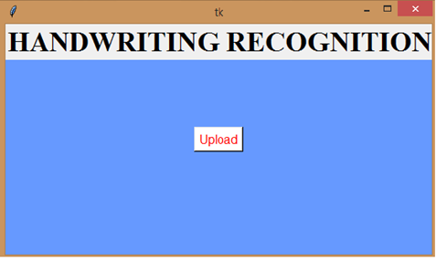
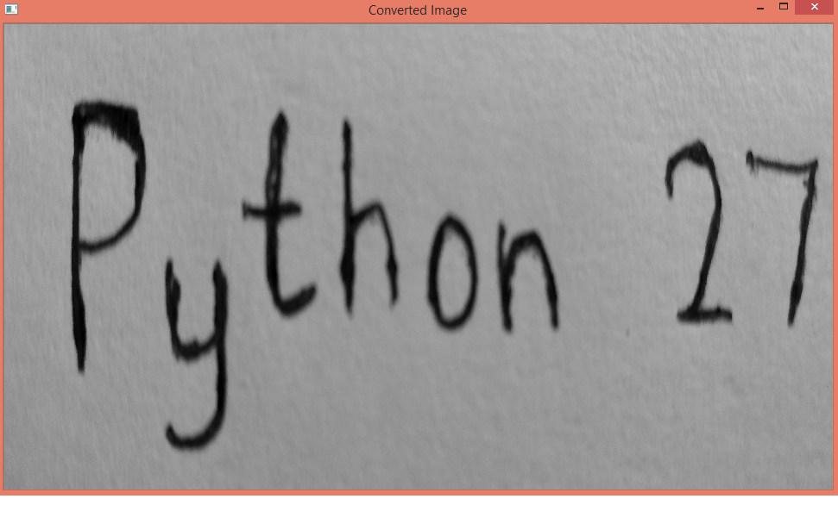
IMAGE CONVERSION

Slide 21
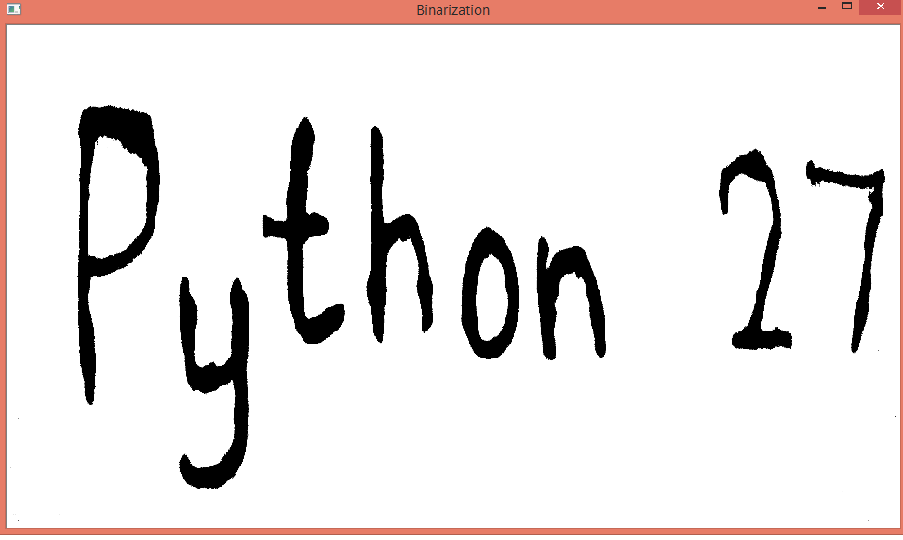
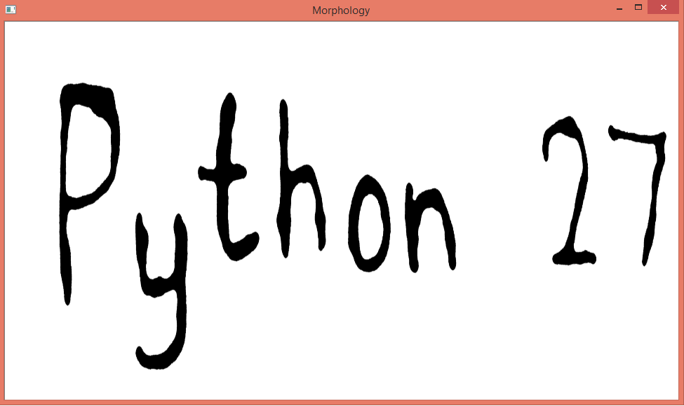
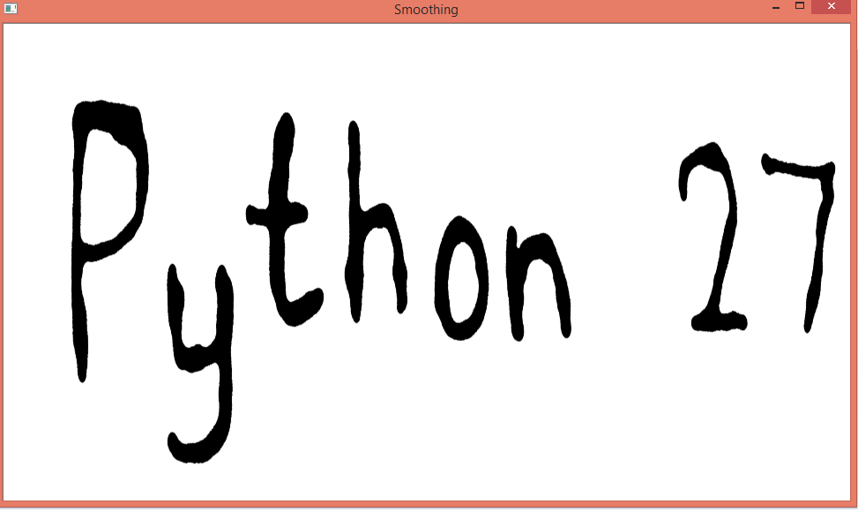
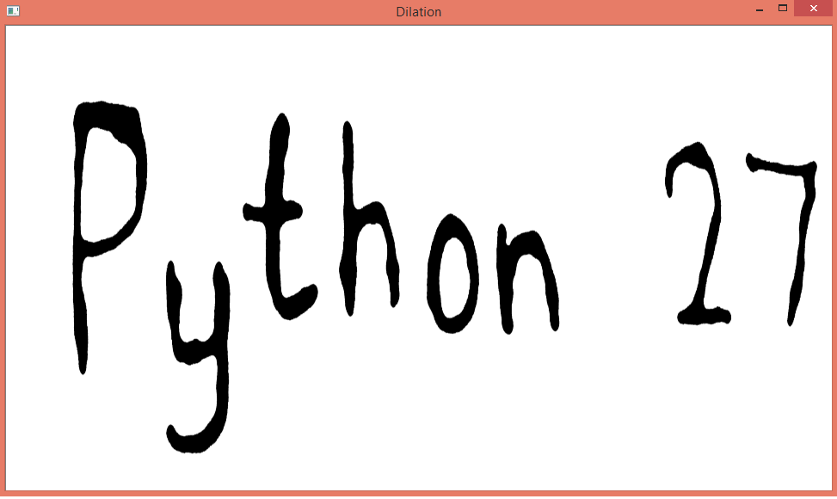
IMAGE PREPROCESSING

Slide 22
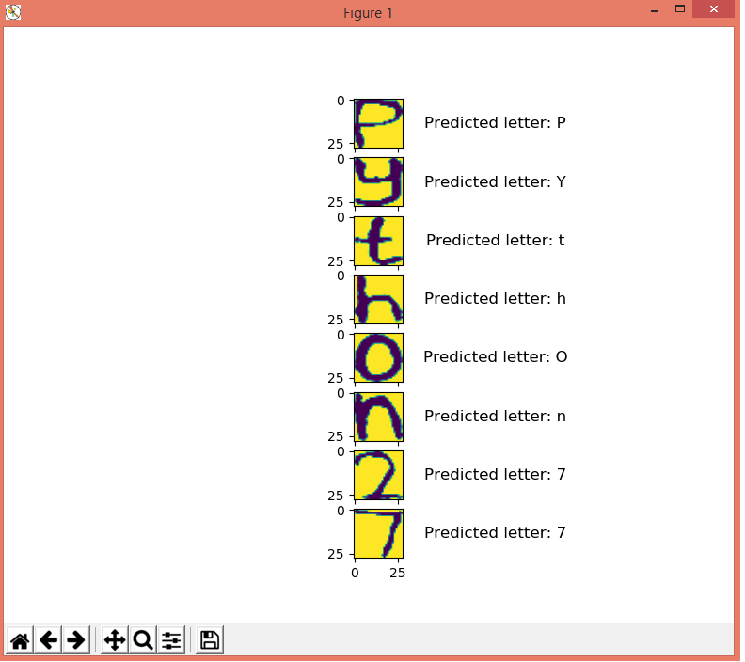
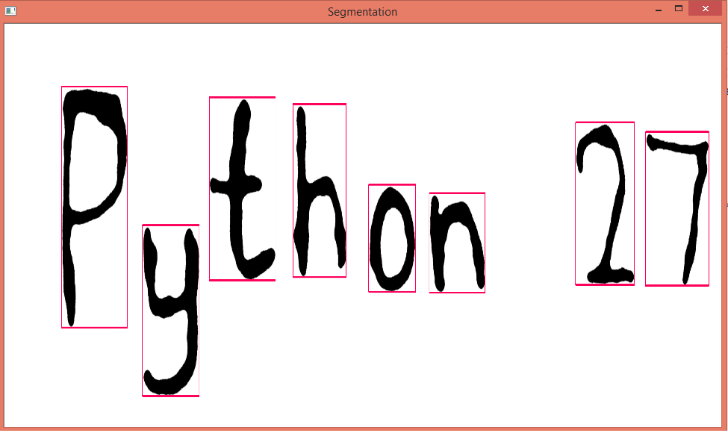
FINAL RECOGNIZED CHARACTER

Slide 23
CONCLUSION
This project uses an enhanced version of 2D-PCA and CNN to perform the HWR process.
One of the uniqueness in this project is the human effort is not required and the project accepts the input in any format (png,jpg,bmp,..)
Colaboratory tool is used to compute the accuracy of the character prediction.
The tool has given an out come of 97.30% accuracy when compared to existing ones 86.56%

Slide 24
FUTURE WORK
The BRISK tool will be used to adopt the building of descriptors which will improve more accuracy.
The proposed system can be scaled up to recognize words and lines.

Slide 25
REFERENCES
AnishaPriya, (2016) ‘Off-line and On-line Character Recognition’,International Conference on Communication and Signal Processing.
Gaurav Kumar, Pradeep Kumar Bhatia, (2013) ‘Neural networks based approach for recognition of text images’, International Journal of Computer Applications,vol. 62,no.14.
Gauri Katiyar, ShabanaMehfuz, (2016)‘A hybrid recognition system for off-line handwritten characters’.
Ankita Katiyar, Gauri Katiyar , ShabanaMehfuz, (2017) ‘Offline handwritten character recognition system using support vector machine’, American Journal of Neural Networks and Applications ,vol. 3, no. 2, pp. 22-28.
Pradeep.J, Srinivasan.E, S.Himavathi, (2011) ‘Neural Network based HandWritten Character Recognition system without feature extraction’, International Conference on Computer, Communication and Electrical Technology.
Savita Ahlawat, Rahul Rishi, (2017) ‘Offline Handwritten Numeral Recognition using Hybrid feature Analysis’,Information Technology and Quantitative Management.
Siddhi Sharma, Neetu Singh, (2014) ‘Optical character recognition using artificial neural network approach’, International Journal of Emerging Technology and Advanced Engineering,vol.4, no.11.
Xin Wang,Ting-lei Huang, Xiao-yu Liu, (2009)‘Handwritten character recognition based on BP neural network’, Third International Conference on Genetic and Evolutionary Computing.

Slide 26
THANK YOU

